Slide 1
Simulating Mushroom Fairy Rings with Cellular Automata
Chris Goralka, Michael Larson, Jayson Rook, Indrima Upadhyay, and Jacob Veta

Slide 2
Outline
Background - Fungi & Fairy Rings
Cellular Automata Method of Modeling
Experimental Target Parameters
Base Model (First Approximation)
Modified Models
Neighborhood Modification
Obstruction Modification
Initialization Modification
Death Rate Modification
Compiled User Interface for Research / Exploration

Slide 3
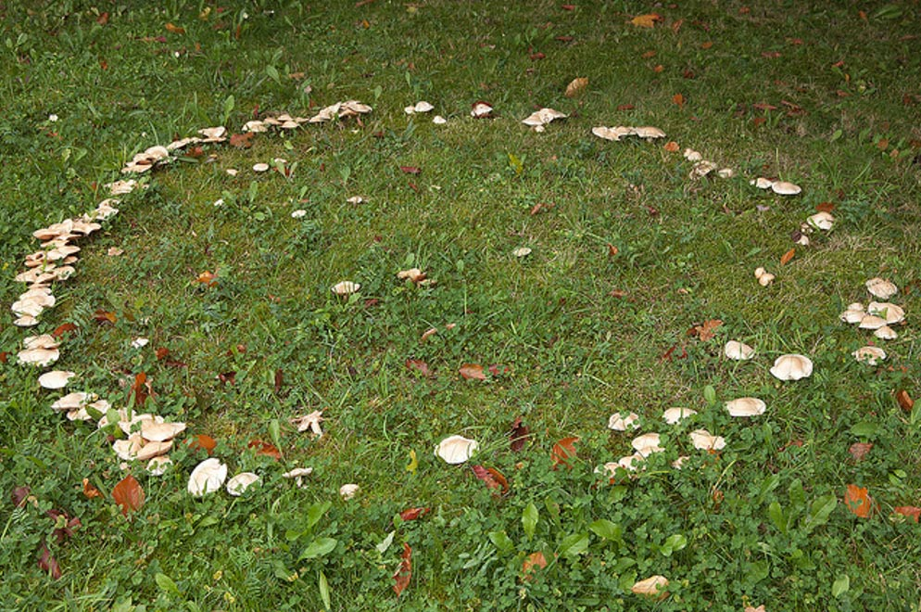
Background - Fungi & Fairy Rings
Marasmius oreadas
Grows in grassy areas during summer and fall
Grow in rings that can damage lawns
Edible, but there are poisonous look alikes
Singular connected underground organism with flowering bodies, referred to as hyphae

Slide 4
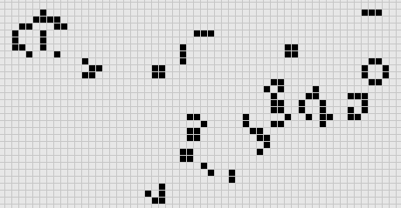
Cellular Automata Method of Modeling
Each cell influences those around it
Zero-player game, only input is initial conditions
Represented by colored cells corresponding to stages of life

Slide 5
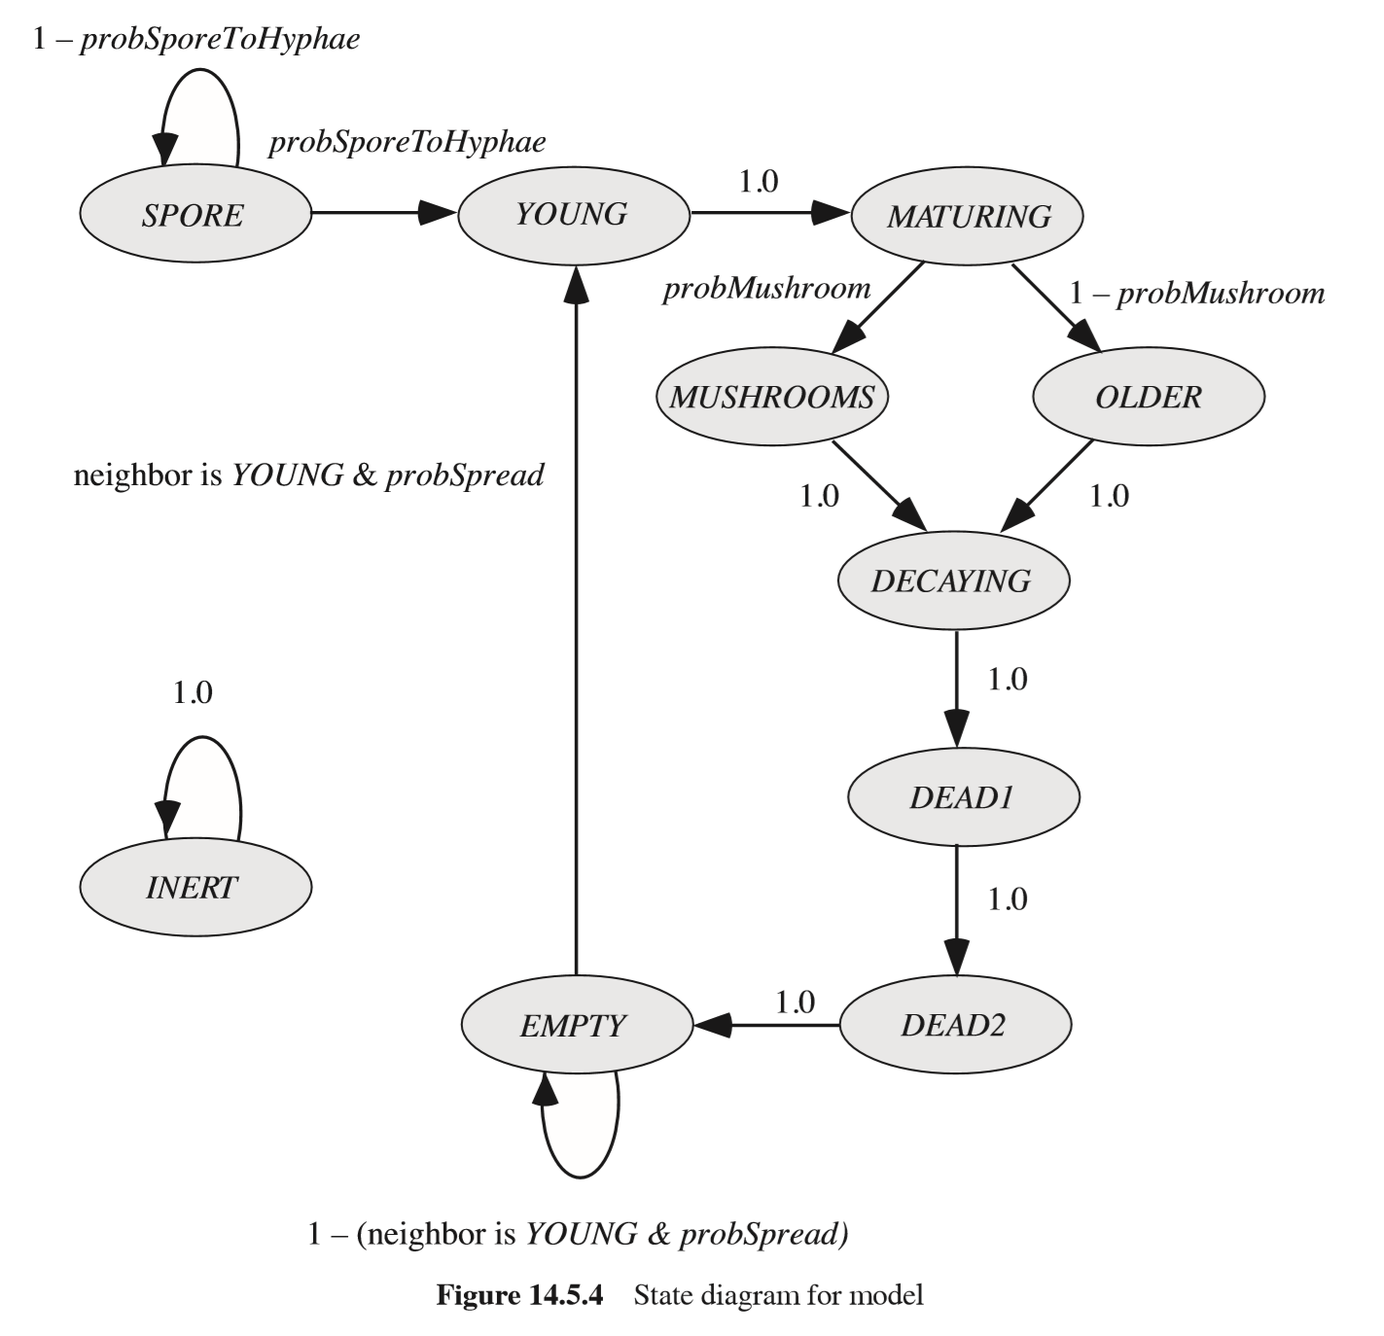
Cellular Automata for Mushrooms
Cell Conditions
Spore
Young
Maturing
Mushrooms
Older
Decaying
Dead
Dead
Empty
Inert - used for obstructions
Notes:
Maturing doesn’t necessarily mean mushroom

Slide 6
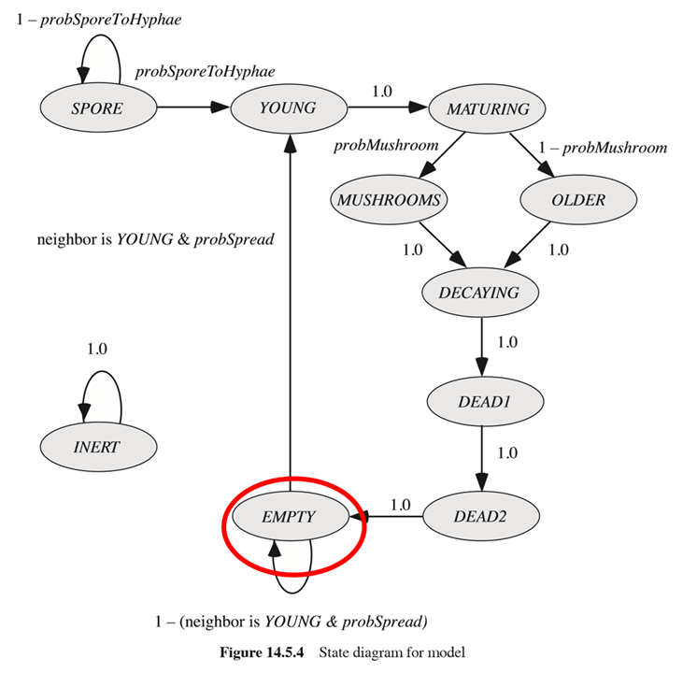
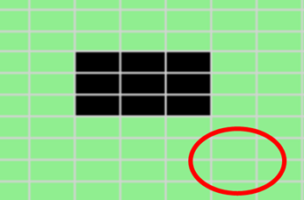
Cellular Automata for Mushrooms
EMPTY - cells that might become YOUNG if any neighbors are YOUNG

Slide 7
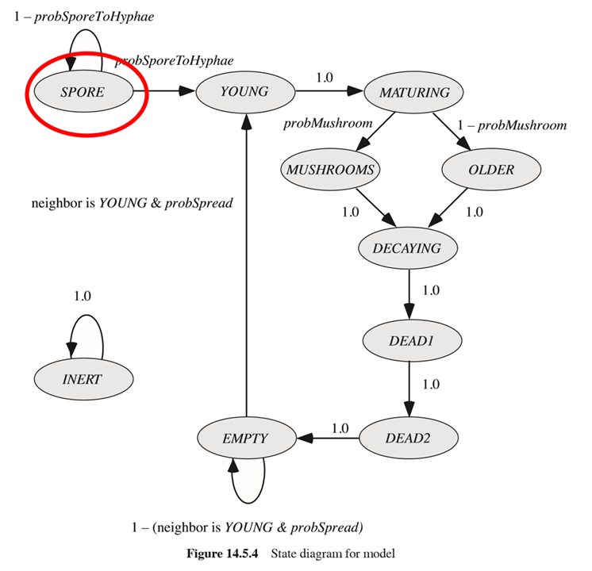
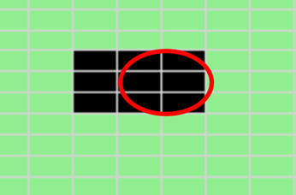
Cellular Automata for Mushrooms
SPORE - spores are present initially, with rings growing outward from them

Slide 8
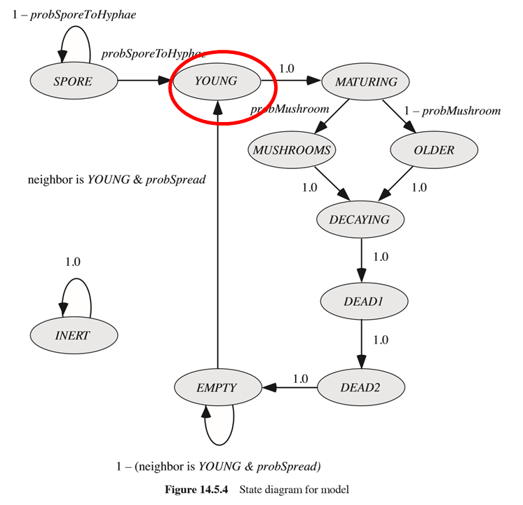
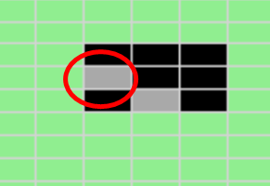
Cellular Automata for Mushrooms
YOUNG - cells can spread to EMPTY neighbors in this state, before MATURING

Slide 9
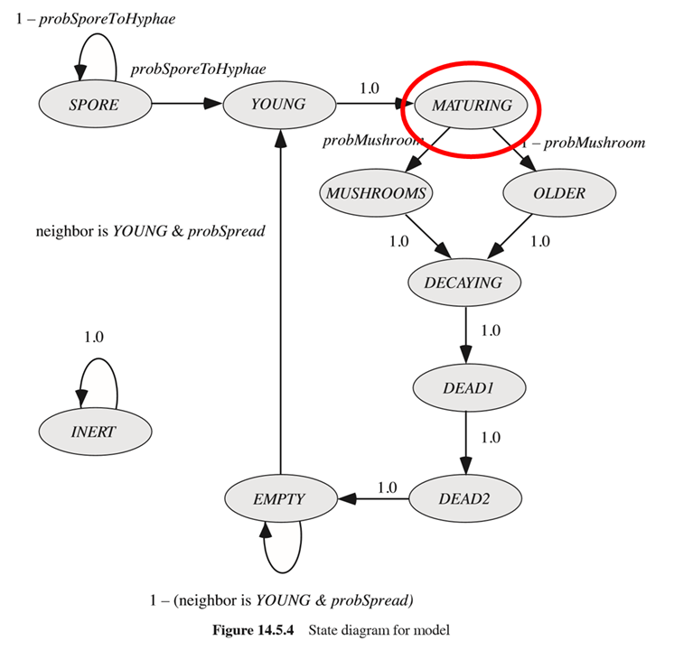
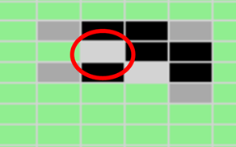
Cellular Automata for Mushrooms
MATURING - intermediate state, representing time between creation and observable mushrooms / death

Slide 10
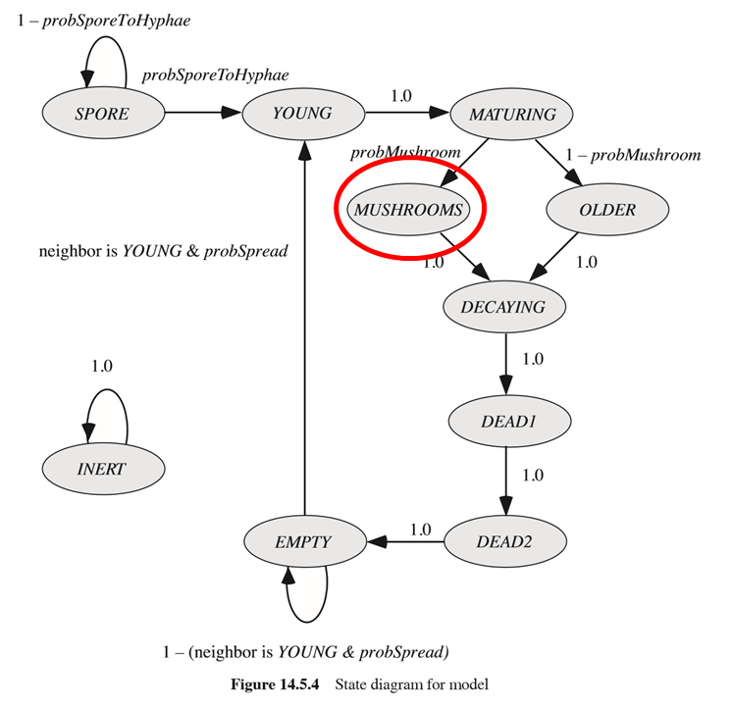
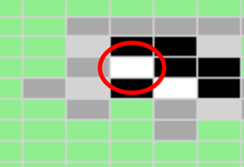
Cellular Automata for Mushrooms
MUSHROOMS - the main observable state, used to track ring’s growth

Slide 11
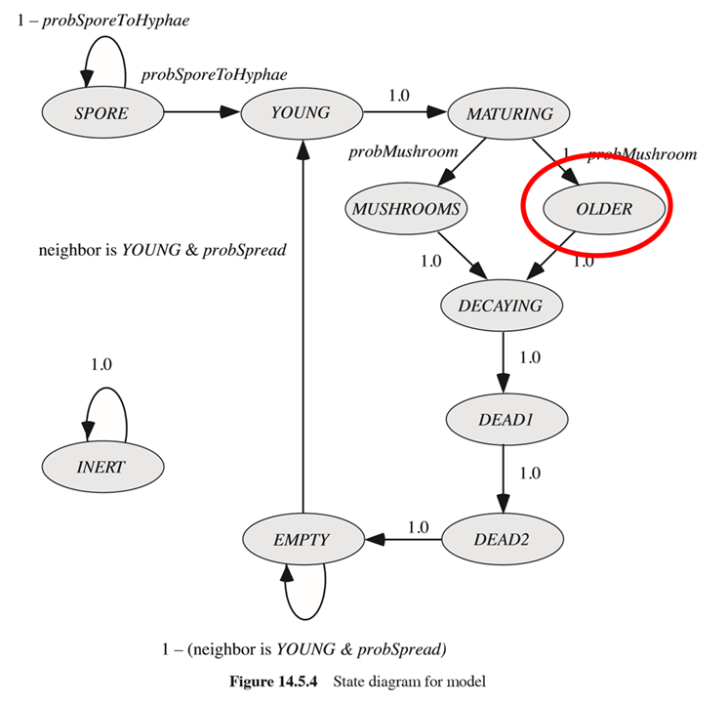

Cellular Automata for Mushrooms
OLDER - intermediate state for cells which go through the fungi’s life cycle, but are never observed as yielding mushrooms

Slide 12
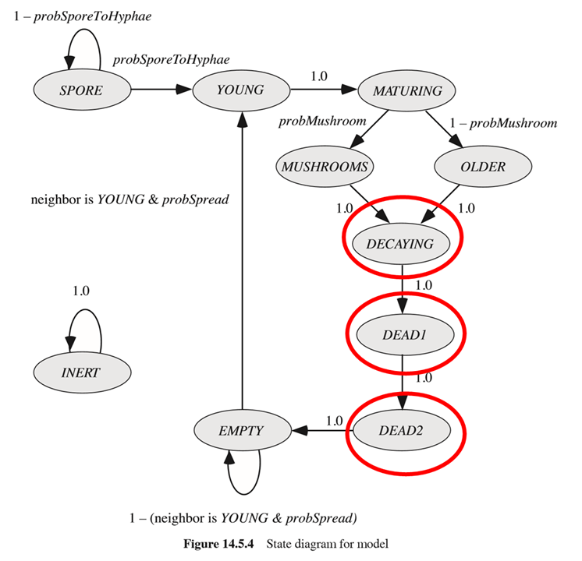
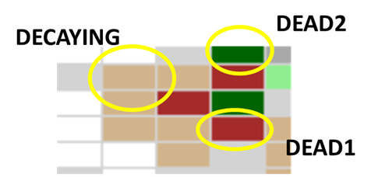
Cellular Automata for Mushrooms
DECAYING, DEAD1, DEAD2 - set amount of time after mushrooms, before cell is empty and can grow fungi again

Slide 13
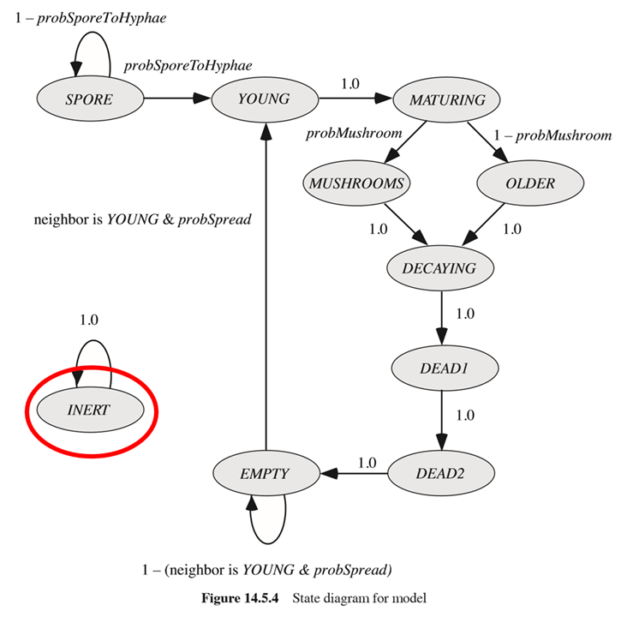
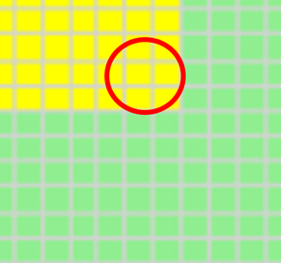
Cellular Automata for Mushrooms
INERT - fungi cannot spread here (barrier)

Slide 14
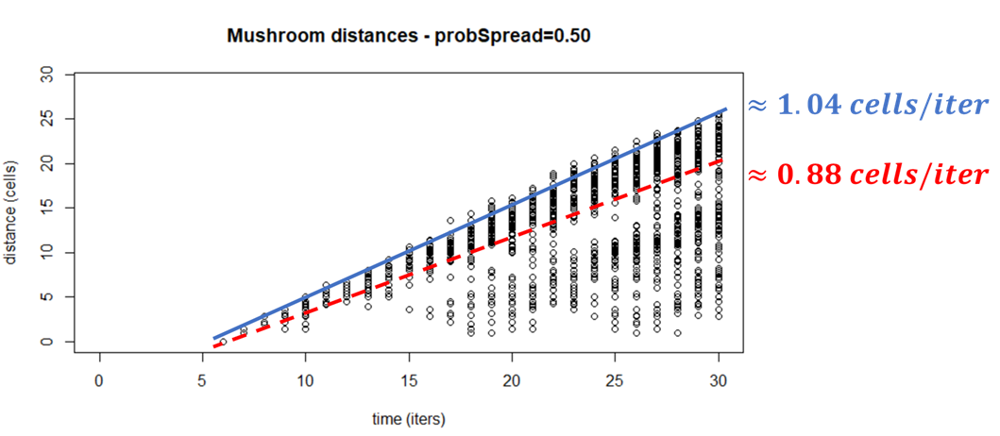
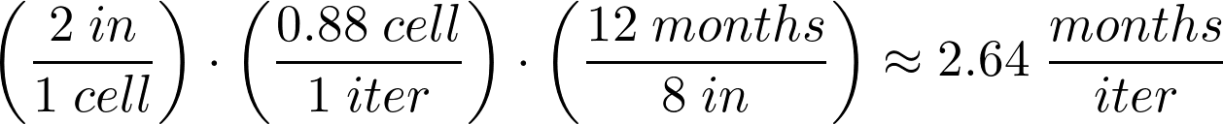
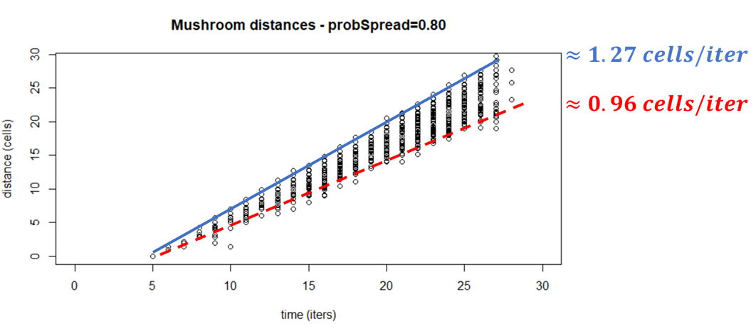
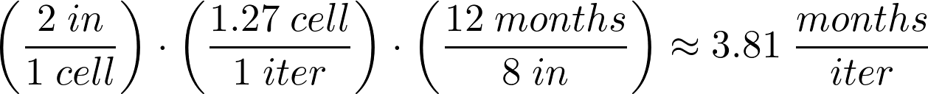
Experimental Target Parameters
1 mushroom = 1 cell, so make cell dimensions equal to reasonable mushroom diameter of 2 in
Experimental radial growth rate is
~8 in/yr, compare to simulation to compute iteration length:
These bounds are somewhat reasonable, since 1 iteration should be about 1 lifetime for a mushroom => 4 - 12 months
Notes:
For purposes of fitting our model to experimental data, we wanted to go ahead and show how we determined the scaling - how big a cell is, and how long an iteration is. Since all the mushrooms that pop up occupy one cell, we made the cell’s side length equal to the typical diameter for our species (Marasmius oreadas) at 2 inches. We also found that fairy rings of this species grow outwards at a maximum rate of about 8 inches per year. So if we compare this rate to the growth rates we observe from the simulation, dimensional analysis gives us the approximate duration of one iteration. The graphs on the right are the mushrooms’ radial distances from their originating spore, plotted as a function of time in iterations. These slopes vary based on parameters, giving us a lower bound for iteration time of 2.64 months/iteration and and upper bound of 3.81 months /iteration. Since we really don’t have this high of precision in our experimental values, the bounds seem fairly reasonable for the length of an iteration - the reason being that the mushrooms life is one iteration long, and we know these mushrooms typically live anywhere from 4 to 12 months.
\begin{align*}
\left( \dfrac{2 \hspace{3pt} in}{1 \hspace{3pt} cell} \right) \cdot \left( \dfrac{0.88 \hspace{3pt} cell}{1 \hspace{3pt} iter} \right) \cdot \left( \dfrac{12 \hspace{3pt} months}{8 \hspace{3pt} in} \right) \approx 2.64 \hspace{3pt} \dfrac{months}{iter}
\end{align*}

Slide 15
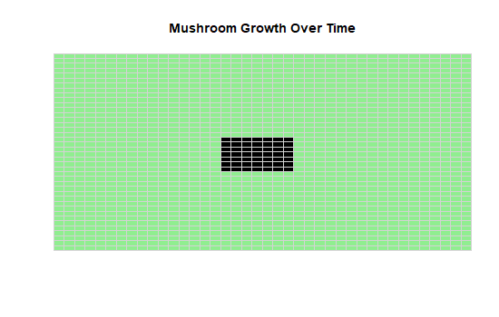
Base Model (First Approximation)
Simple model with no obstructions or modifications
Shown here with 40x40 grid, 20 iterations, 0.5 probSpread

Slide 16
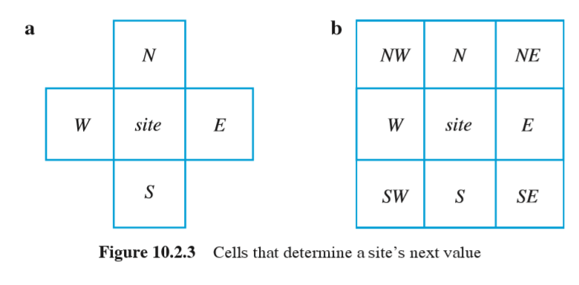
Modifications - Neighborhood
Von Neumann
Moore
At higher values of probSpread, the neighborhood has a visible impact on the ring’s shape
Fungi not confined to a grid in reality, so growth rate should be independent of direction
Notes:
One modification we considered was changing the automata’s “neighborhood”, or which of a cell’s neighbors can influence its state. In our case, the neighborhood controls only which EMPTY cells may become YOUNG cells, based on other YOUNG cells in the neighborhood. The textbook defines these two common neighborhoods, where Von Neumann allows spread only in cardinal directions and Moore considers all 8 surrounding cells. Many of our trials have used the Moore neighborhood, but under certain parameters (particularly high probSpread values), the ring’s shape starts to mirror the neighborhood. (next slide)

Slide 17
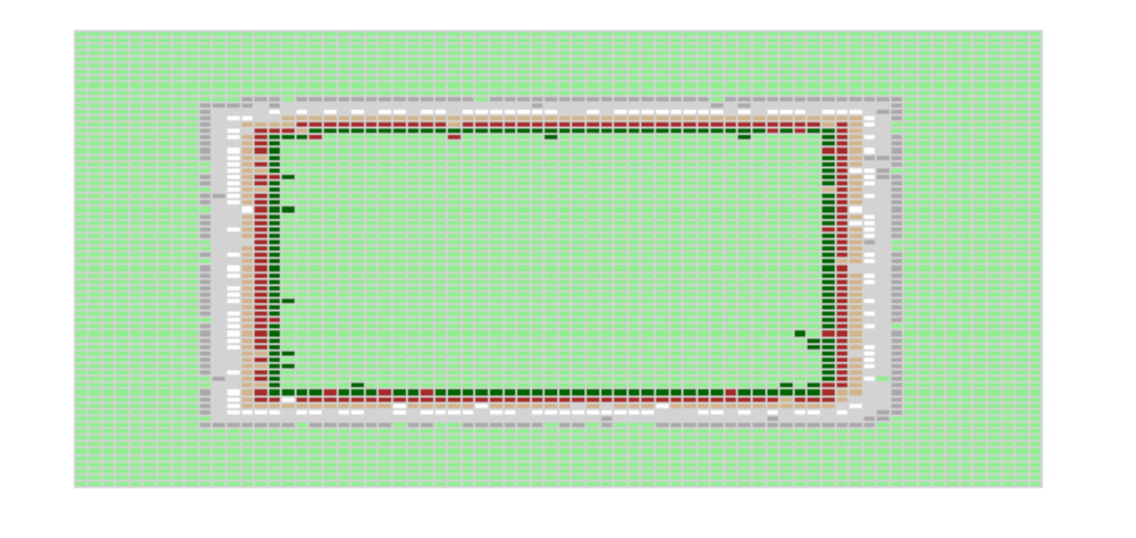
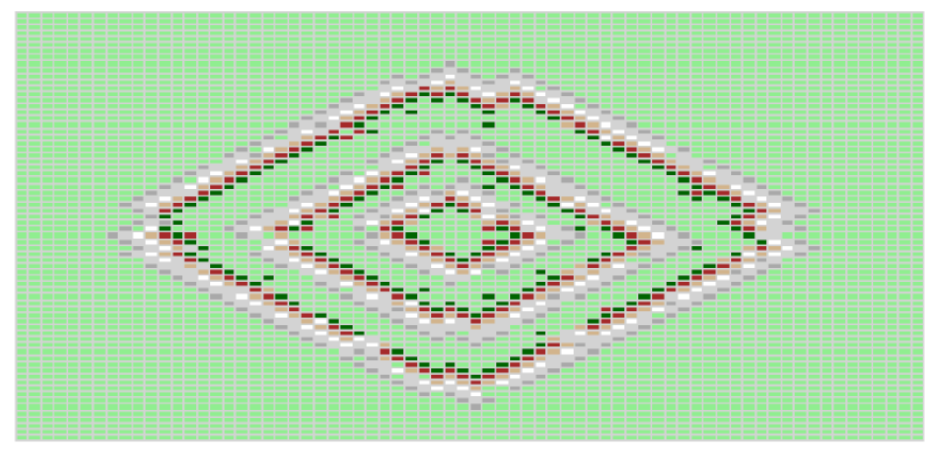
Modifications - Neighborhood
Von Neumann
Moore
Notes:
Here with probSpread = 0.9, the results for using purely Von Neumann or purely Moore neighborhoods is shown. The square and diamond shape are only have rotational symmetry every 90 degrees. This is naturally unrealistic, since fungi in reality are not confined to a square grid and should have roughly equal growth rates in all directions.

Slide 18
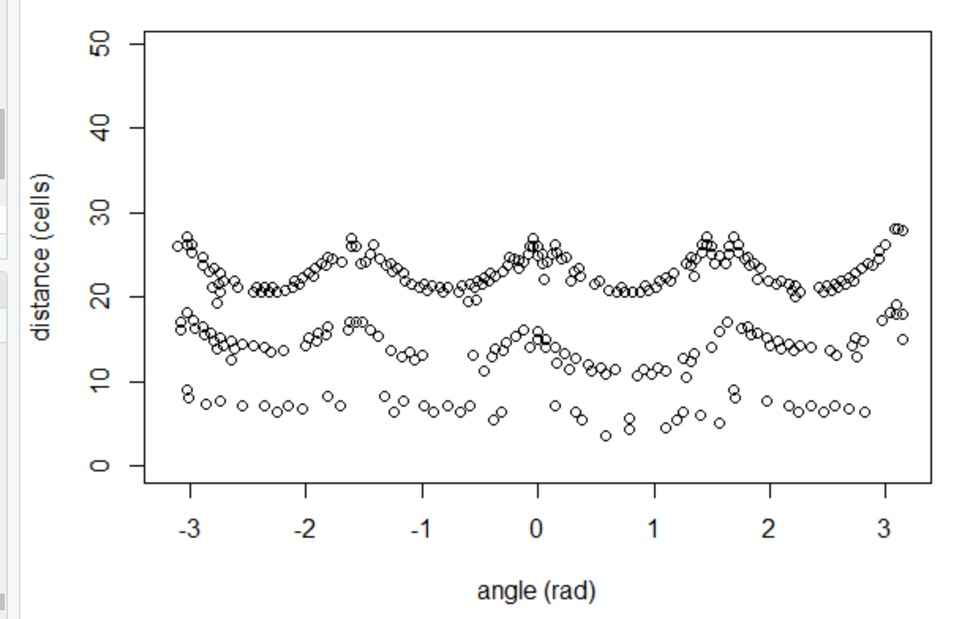
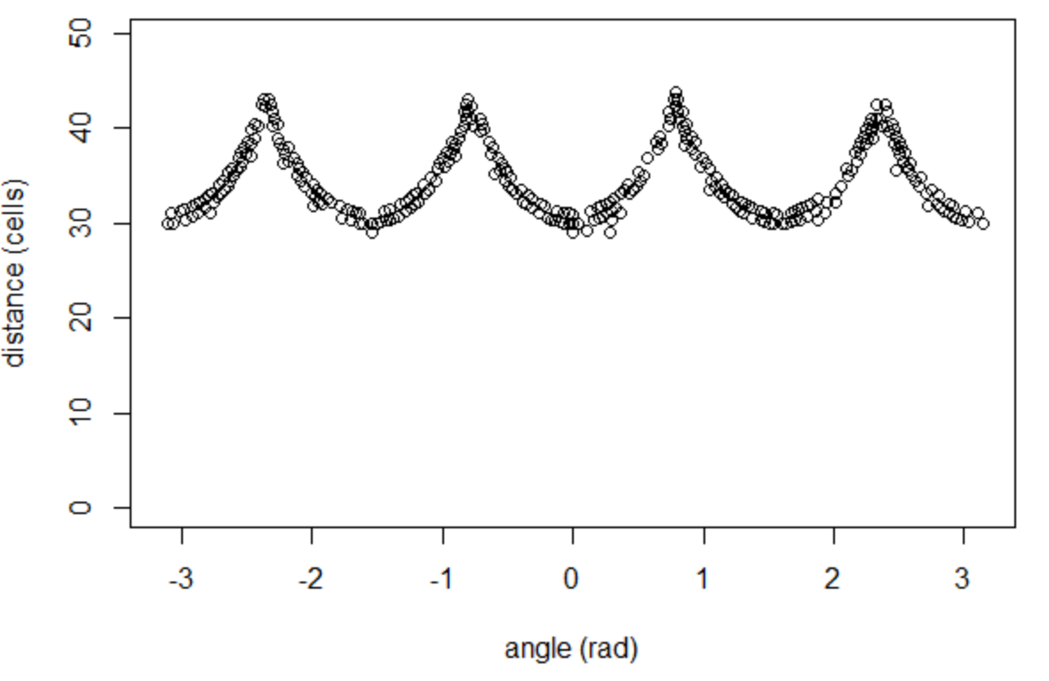
Modifications - Neighborhood
Consider mushroom locations in polar coordinates to see bias in cardinal or diagonal directions
Von Neumann
Moore
Notes:
If we capture locations of all the mushrooms over a couple of consecutive iterations, plotting their polar coordinates shows the radial distance varying with polar angles, demonstrating a directional bias in growth rate. To have true rotational symmetry, these plots should approximate horizontal lines.

Slide 19
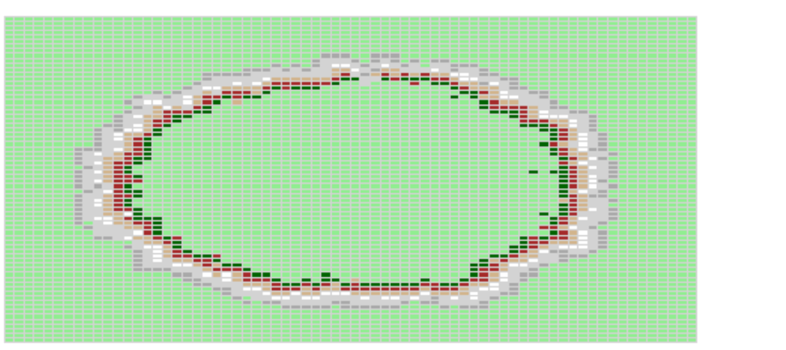
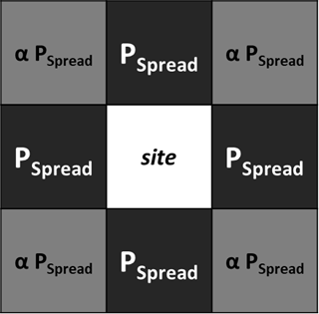
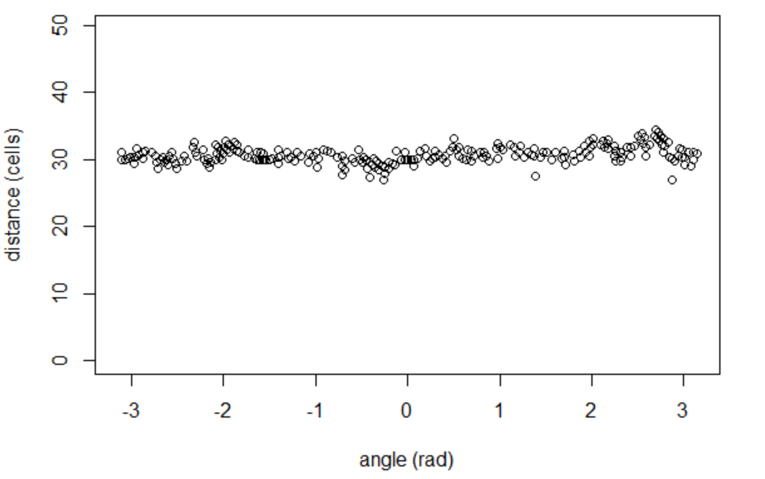
Modifications - Neighborhood
Can we remove this bias?
P_{spread} = 0.9
α = 0.3
α = 0: Von Neumann
α = 1: Moore
Notes:
To try and remove this bias, we consider both neighborhoods together, but give the larger, Moore neighborhood a lower probability by some proportionality constant alpha. Ideally, this represents that diagonal neighbors are of course about 1.4 cell units away - so the spread shouldn’t be as quick or likely as spread to cardinal direction neighbors only 1 cell away. But, the diagonal neighbors are still closer than 2 cells away, which would be the case using purely cardinal direction spreads. Determining what alpha should be analytically is tricky - we could try (for instance) to consider a Markov model of all the possible states in a small group of cells, but even with a simple model the math gets complicated and very nonlinear very quickly. So, determining alpha through simulation gave us about 0.3 when probSpread was 0.9. So that’s saying when a cell is in the YOUNG state, its EMPTY cardinal neighbors have a 90% of becoming YOUNG, and its diagonal neighbors have only a 27% chance. And you can see that gave us a much rounder, direction-independent growth shape.

Slide 20
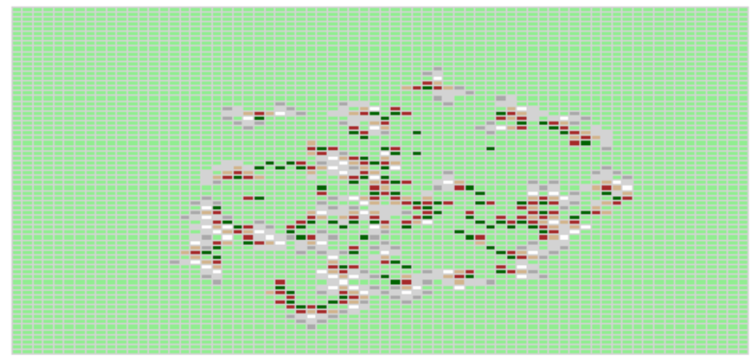
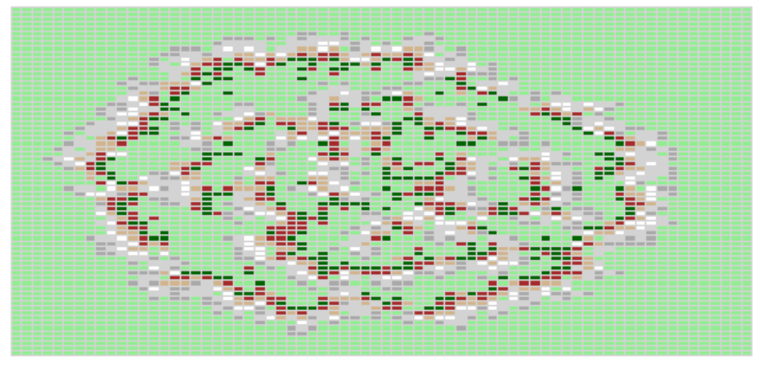
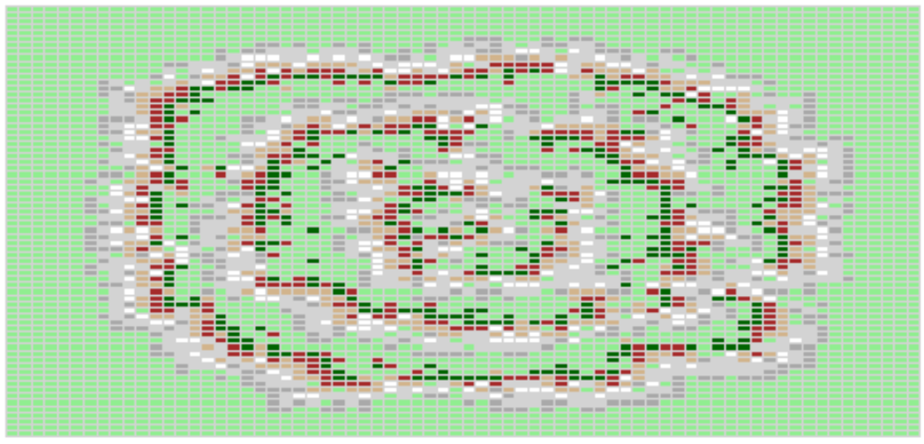
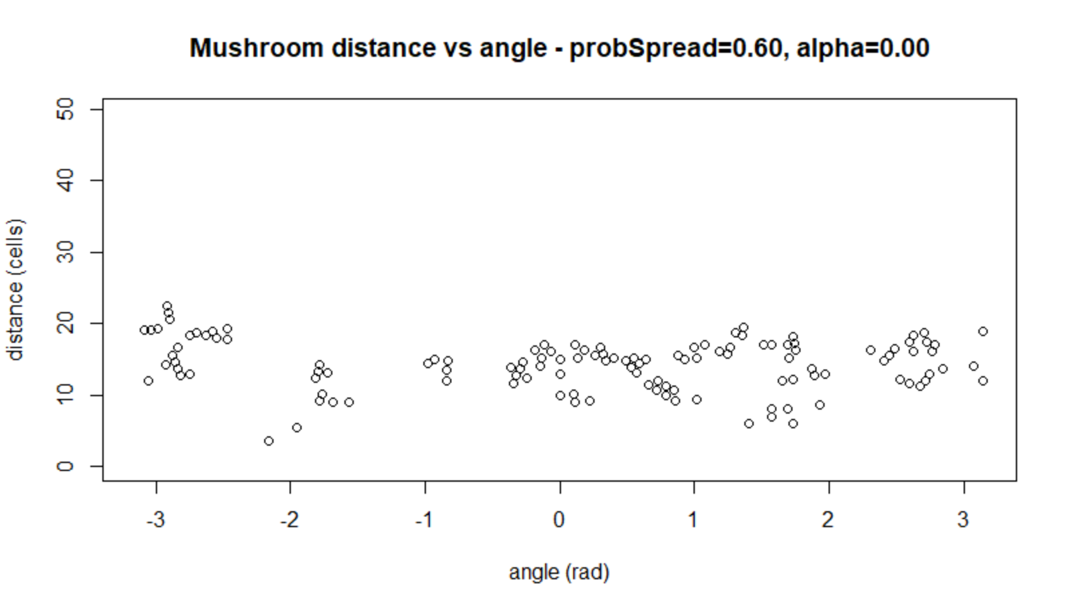
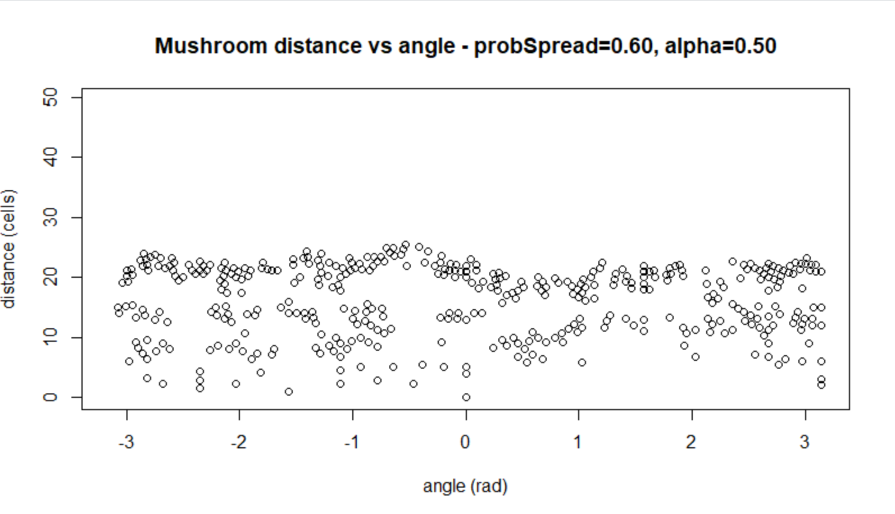
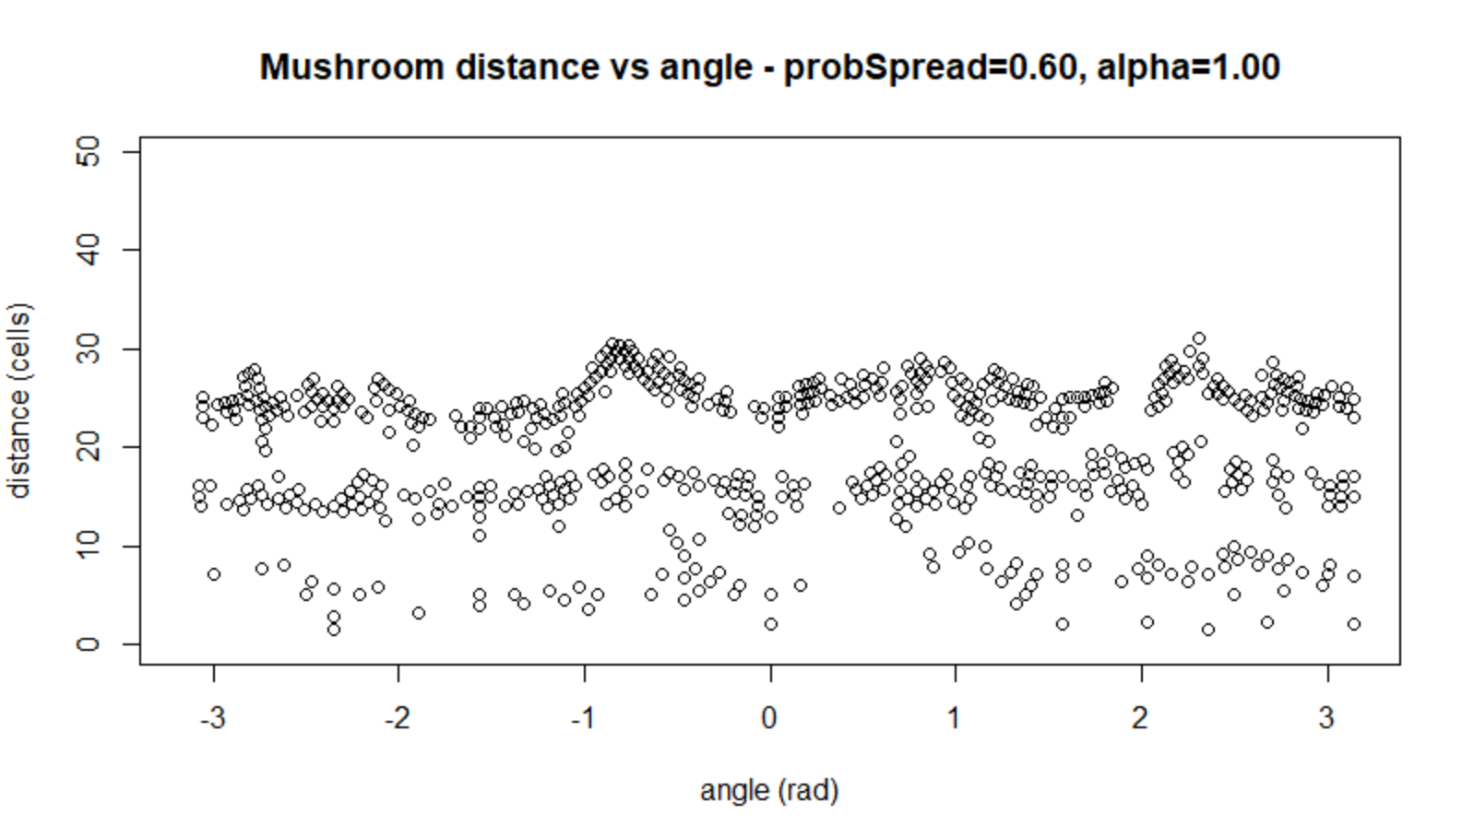
Modifications - Neighborhood
Behavior is different for lower values of probSpread (0.6 here)
α = 0
α = 0.5
α = 1
Notes:
One more thing to note is the behavior (and the ideal alpha values) vary when probSpread changes. When we lower it to 60%, the Von Neumann neighborhood no longer makes a diamond - or even rings at all for that matter. As we raise alpha we start to see more defined and circular outer rings, before alpha becomes too high and starts yielding square rings again. So changing the neighborhood we saw can make the rings more rotationally symmetric, but it takes some tuning to choose that parameter correctly.

Slide 21
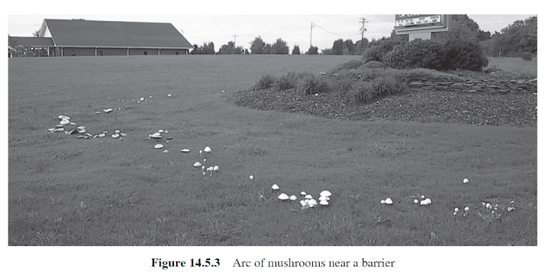
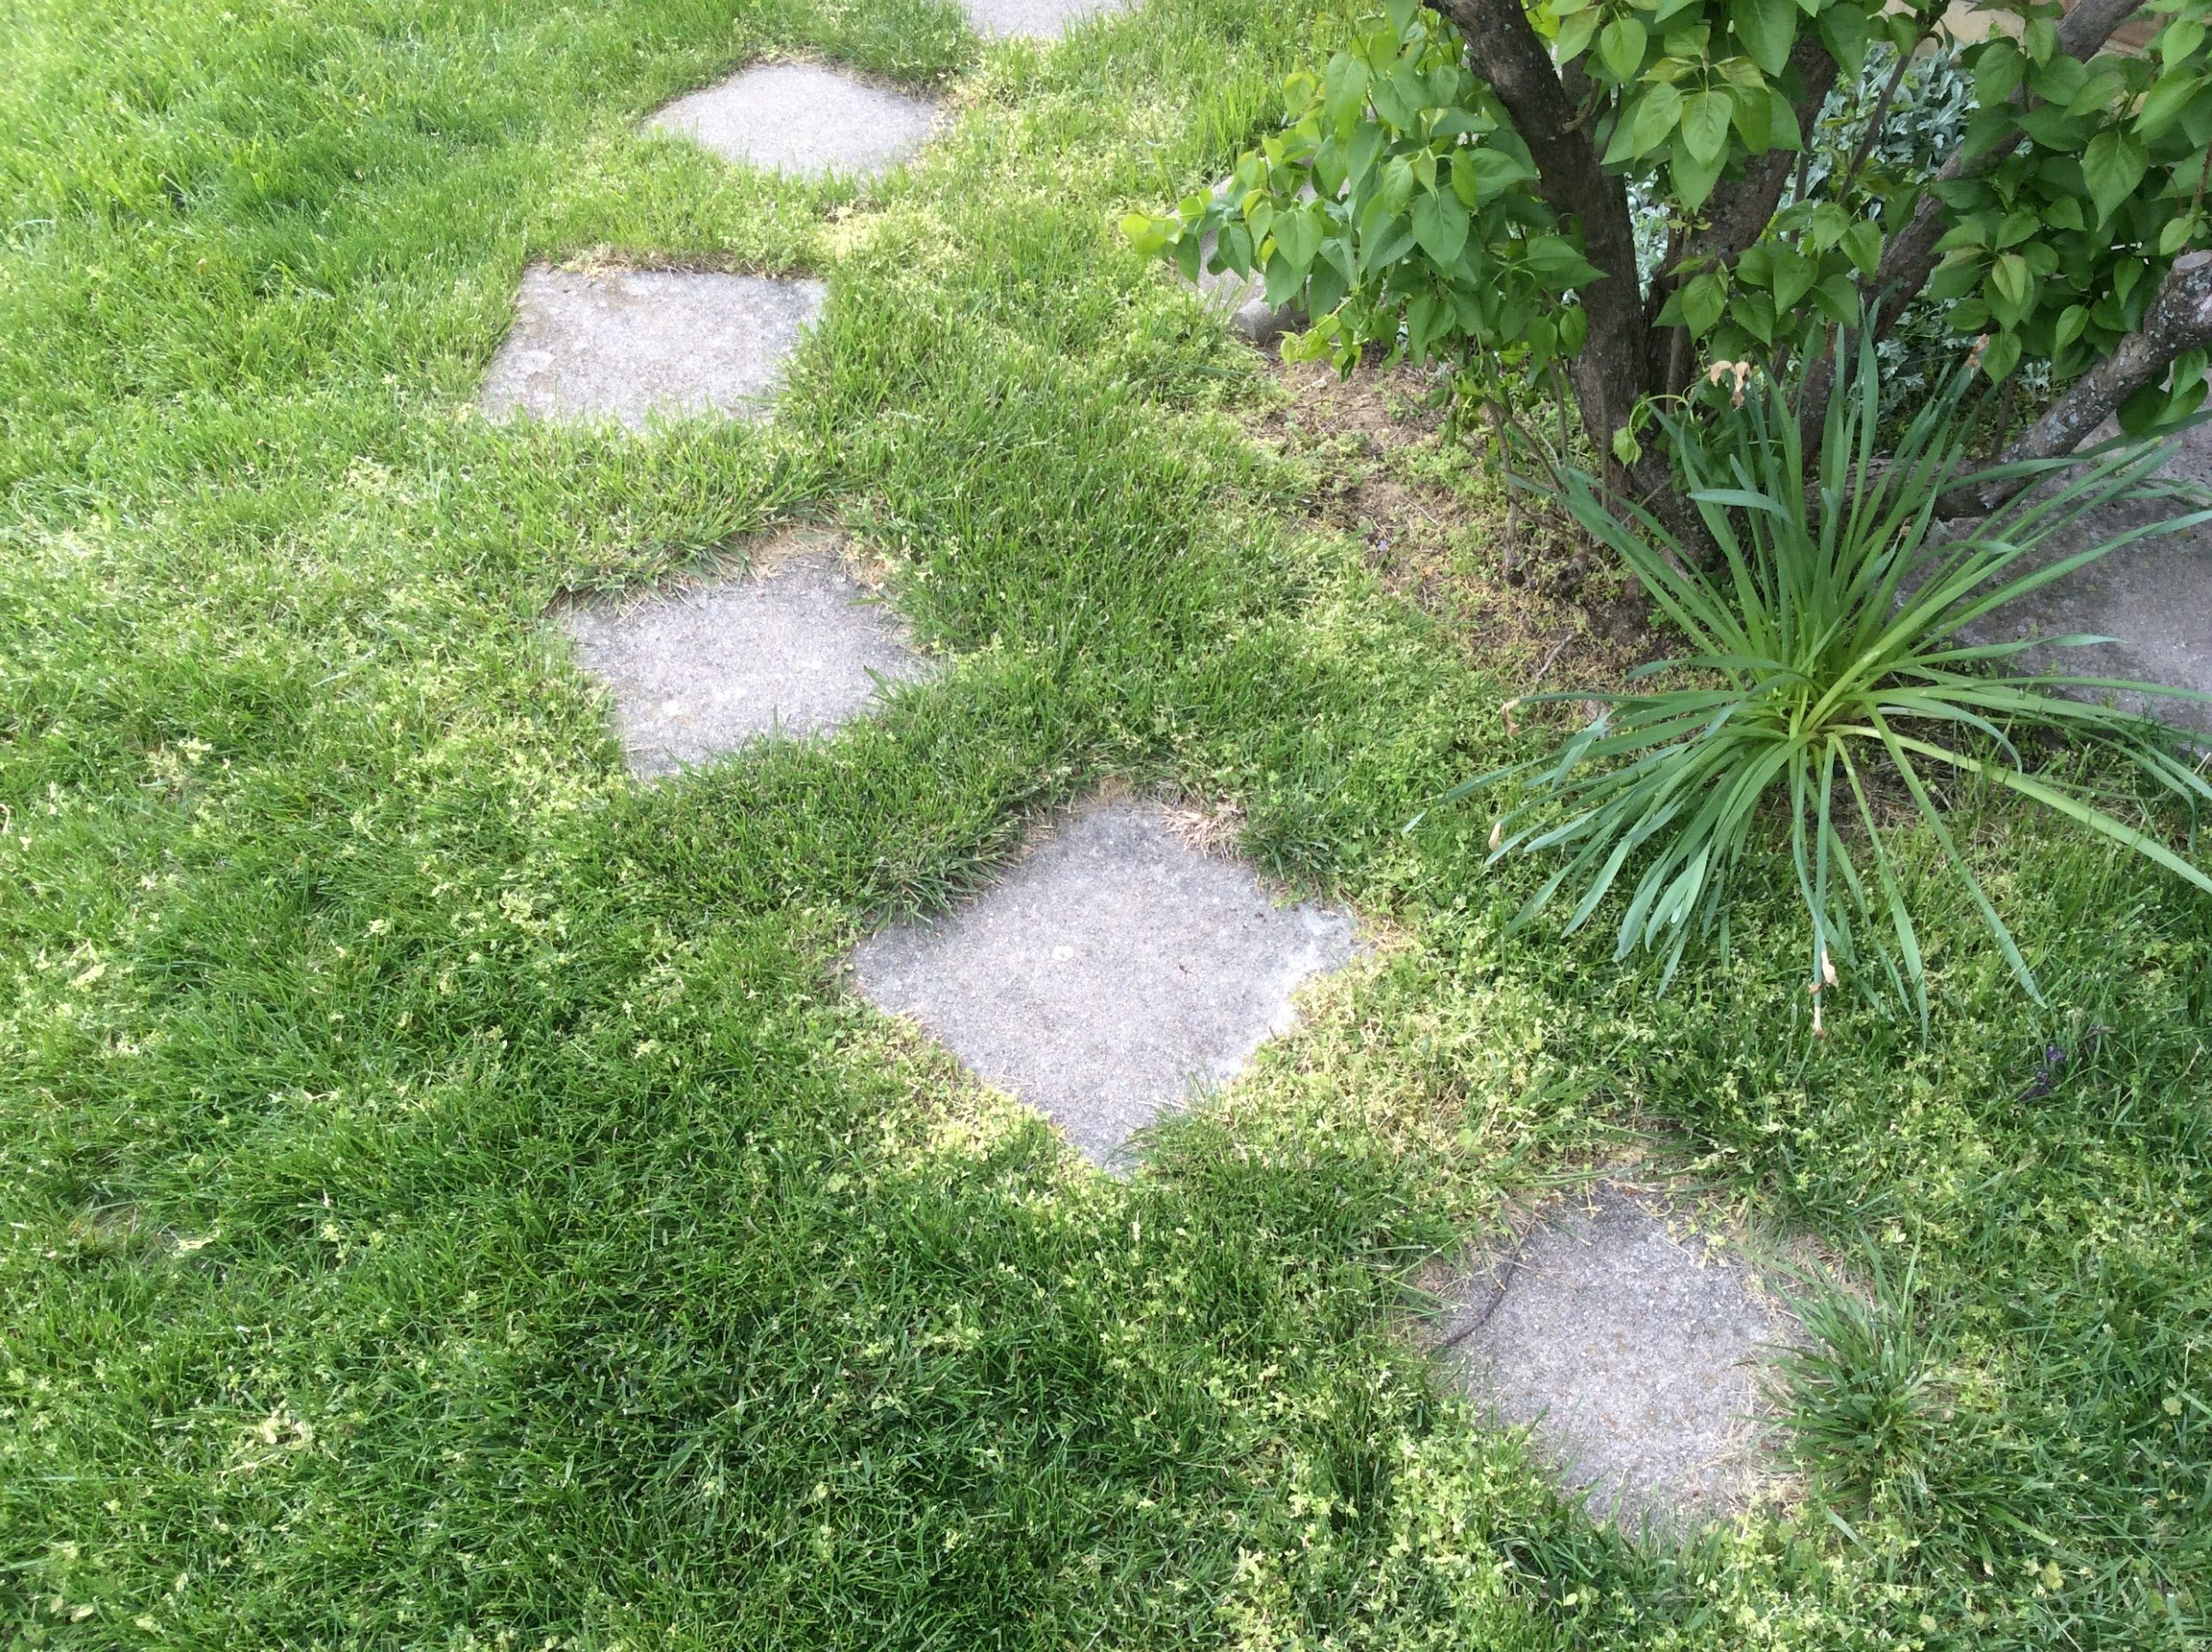
Modifications - Obstructions
There are some barriers mushrooms can’t grow through => what happens?
Code initialized with dictated areas of inert space (non-inhabitable)
Notes:
The next modification we made to the code was examining mushroom growth when it encounters an obstruction. There are some barriers that mushrooms can’t grow through, so what happens? On the right, you can see a picture from our textbook showing some kind of mound blocking a fairy ring from growing. On the left is a picture of a stone path in my backyard that similarly would obstruct mushroom growth. It was this segmented path that we decided to model with inert space, so the code was initialized with those cells at the start of the simulation.

Slide 22
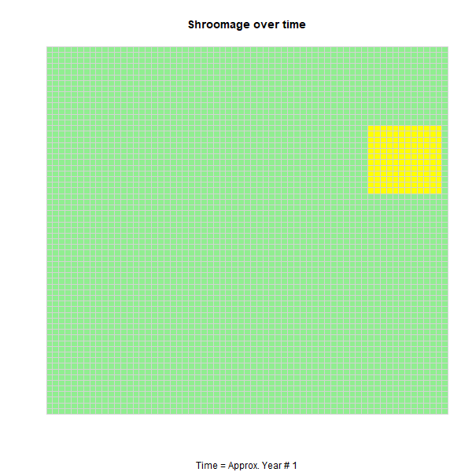
Modifications - Obstructions
Confirmed hypothesis of wave-like diffusive behavior after penetrating obstruction
Once the first row of ‘shrooms passes through the obstruction opening, they want to grow left and right again
This leads to the same curve on the other side
Notes:
Before we completed this, a group member hypothesized that since the fairy ring expands like a wave, that it would exhibit wave-like diffusive behavior after permeating between obstructions. Once the first row of mushrooms passes through the obstruction opening, the first row of cells beyond that inert space will have empty cells to their left and their right. The mushrooms then grow to the left and right, but delayed behind the forefront rows. The merging of these diffused waves then re-merge to form a fairy ring again.

Slide 23
Modifications - Obstructions
Similar behavior, small foreshadowing of interaction between two rings (see later slides)
Diffused waves intermingle for a “deformed corner” in the bottom right
Notes:
In this simulation, the same obstruction has been initialized but with a different starting spore location. We can see a similar behavior as the ring starts, and even a little bit of foreshadowing as it passes through the two leftmost obstructions. The two diffused waves reconnect and intermingle to form a deformed corner. This is because on the previous slide, the initial spores in the bottom right had less horizontal distance to travel. In this case, the fairy ring has to travel farther to right, and that increase in travel essentially delays the diffusion of its wave through the middle two obstructions. Then, when it regroups, it forms that dented wave.

Slide 24
Modifications - Obstructions
Odd/rare anomaly where the interacting diffused waves of mushrooms generate a new propagation
Possible for the ‘dead’ (brown) cells to become shifted from each other, allowing a mushroom through
Notes:
In this case, there was an odd anomaly where the interacting diffused waves of mushrooms after generated a new propagation of rings. Despite initializing spore in the middle (and thus lowering the chance of delaying the rings through the obstructions) because the probability of spreading was less than 1, some mushrooms were also delayed in their growth and spreading. Because of this, a mushroom managed to “slip through” the dead zone and start a new propagation of rings. Again, this was a stochastic system, and this was one strange output of many other normal ones, but was an interesting phenomenon to observe. It’s interesting because one might first think a spreading probability of 1 is the ideal case for growing the maximum number of mushrooms. This shows that that’s not the case; with a probability of growth less than 1, that shift and delay in propagation can occasionally lead to more mushrooms on on plane altogether.

Slide 25
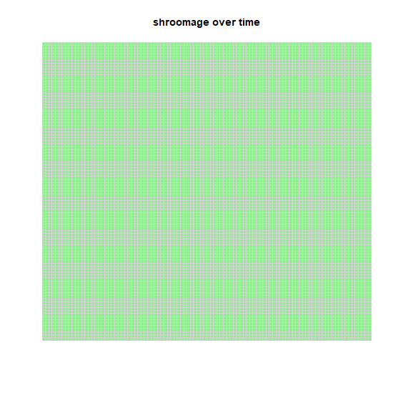
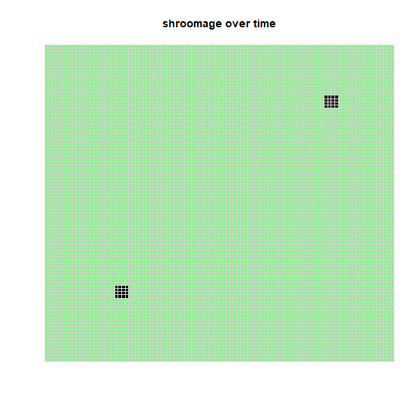
Modifications - Multiple Spore (Starting) Locations

Slide 26
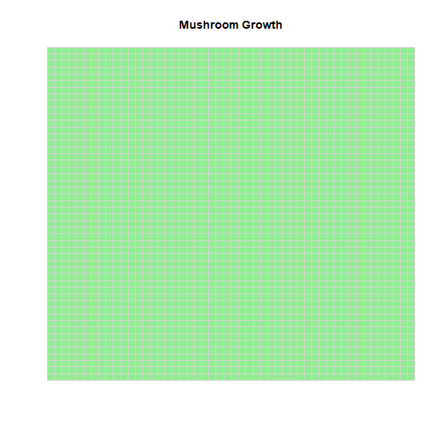
Modifications - Two Species
Two species with identical initial condition (90 spread probability)
Majority of time cancelled each other out and resulted in extinction.
Occasionally one species would “win” over the other
Giving more space to grow resulted in an equilibrium

Slide 27
Modifications - Two Species
Two species with identical initial condition (90 spread probability)
Majority of time cancelled each other out and resulted in extinction.
Occasionally one species would “win” over the other
Giving more space to grow resulted in an equilibrium

Slide 28
Modifications - Two Species
Two species with identical initial condition (90 spread probability)
Majority of time cancelled each other out and resulted in extinction.
Occasionally one species would “win” over the other
Giving more space to grow resulted in an equilibrium

Slide 29
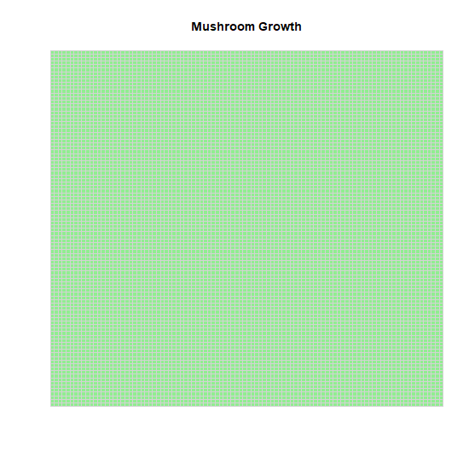
Modifications - Two Species
Two species with identical initial condition (90 spread probability)
Majority of time cancelled each other out and resulted in extinction.
Occasionally one species would “win” over the other
Giving more space to grow typically resulted in an equilibrium

Slide 30
Modifications - Two Species with Different Parameters
Red species has 50 probability to spread.
White species has 90 probability to spread.
Species with higher spread probability almost always won.

Slide 31
Modifications - Two Species with Random Spore Distribution
Spores placed randomly on 10% of map. (Spores released by mushrooms and carried by wind)
Red and white have equal parameters (90 spread prob)
Initial overshoot of carrying capacity (twice).
Mimics odd patterns seen in real life.

Slide 32
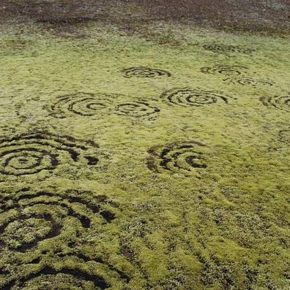
Modifications - Two Species with Random Spore Distribution
Spores placed randomly on 10% of map. (Spores released by mushrooms and carried by wind)
Red and white have equal parameters (90 spread prob)
Initial overshoot of carrying capacity.
Mimics odd patterns seen in real life.

Slide 33
Modifications - Two Species with Random Spore Distribution and Different Parameters
Spores placed randomly on 10% of map.
Red has 70 spread probability, while white has 90.
White won every time

Slide 34
Modifications - Probabilistic Death Rates
Decaying hyphae with exhausted nutrients
Newly dead hyphae with exhausted nutrients
Hyphae that have been dead for a while

Slide 35
Modifications - Probabilistic Death Rates
Visible variations in inner ring of stimulated grass growth
The result of release of nitrogen from the decaying organic matter
Does not affect the central ring as much
Central ring contains the dense mass of “feeding” hyphae
“Dead zones” cause figure-8 pattern of two intersecting fairy rings

Slide 36
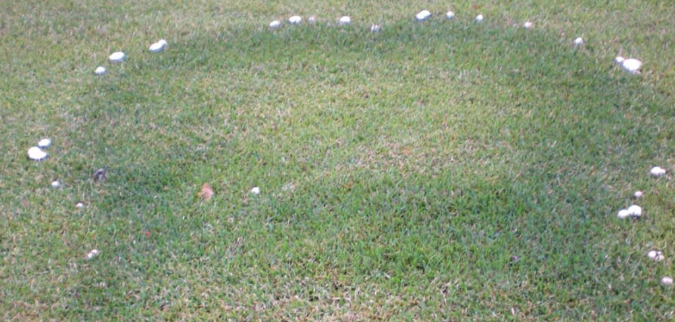
Modifications - Probabilistic Death Rates

Slide 37
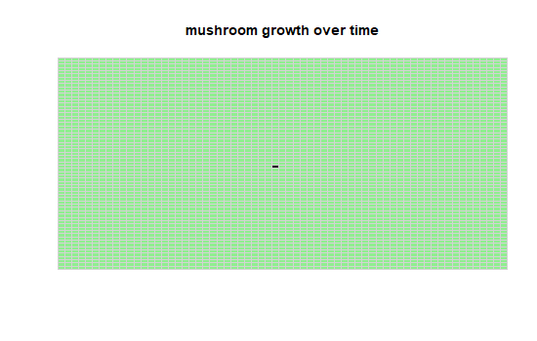
Modifications - Probabilistic Death Rates
Probabilistic Death Rate = 0.1

Slide 38
Modifications - Probabilistic Death Rates
Probabilistic Death Rate = 0.5

Slide 39
Modifications - Probabilistic Death Rates
Probabilistic Death Rate = 0.9

Slide 40
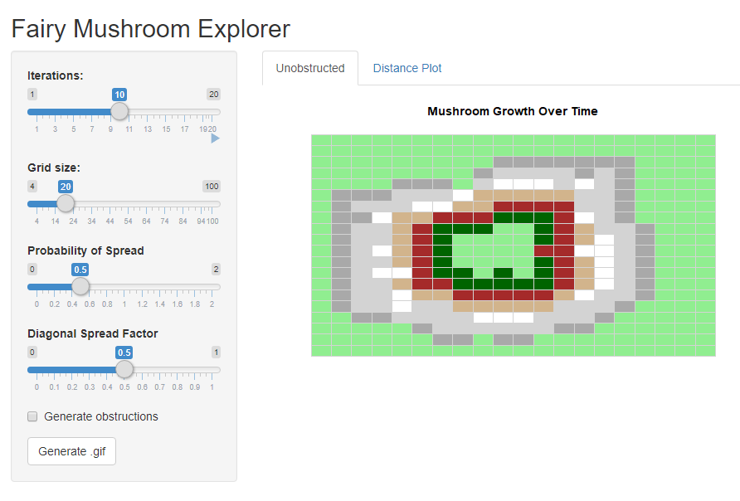
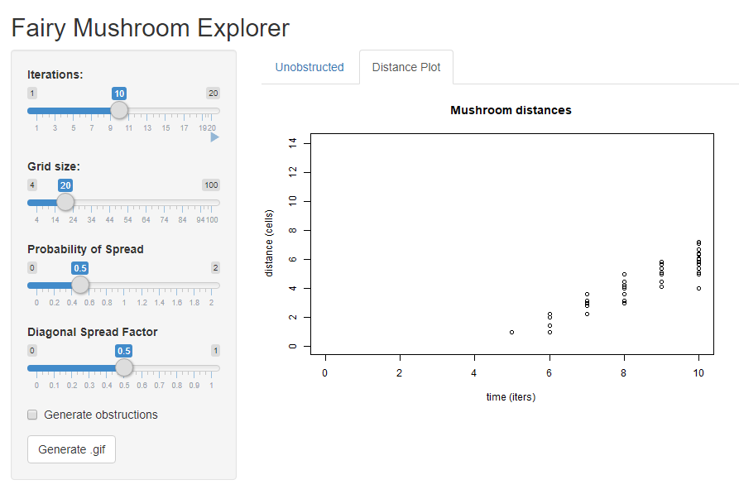
Fairy Mushroom Explorer
RShiny App
Allows for addition of obstructions, modification of parameters in real time
Outputs grid heatmap and mushroom distance plot
Creates time series matrix and can generate a .gif file

Slide 41
References
N. Karst, D. Dralle, and S. Thompson, “Spiral and Rotor Patterns Produced by Fairy Ring Fungi,” PLoS ONE, vol. 11, no. 3, p.e0149254, Mar. 2016, doi: 10.1371/journal.pone.0149254.
Daniel Shiffman, Chapter 7. Cellular Automata, The Nature Of Code
Illinois Extension Service. 1998. Department of Crop Sciences, University of Illinois– Urbana-Champaign. “Fairy Rings, Mushrooms and Puffballs.” Report on Plant Disease No. 403
D. R. Stevenson and C. J. Thompson, “Fairy ring kinetics,” Journal of Theoretical Biology, vol. 58, no. 1, pp. 143–163, May 1976, doi: 10.1016/0022-5193(76)90144-2.
C. G. Dowson, A. D. M. Rayner, and L. Boddy, “Spatial dynamics and interactions of the woodland fairy ring fungus, Clitocybe nebularis,” New Phytologist, vol. 111, no. 4, pp. 699–705, 1989, doi: 10.1111/j.1469-8137.1989.tb02365.x.
Kruszelnicki, Karl S. “Great Moments in Science—Fairy Rings.” Karl S. Kruszelnicki Pty Ltd. http://www.abc.net.au/science/k2/moments/s297489.htm
Angela B. Shiflet and George W. Shiflet, Module 14.5, Mushroom Fairy Rings—Growing in Circles, Introduction to computational science: Modeling and simulation for the sciences, pp. 748–756, Princeton U. Press, Princeton, NJ, 2006.

